Slide 1
Matchmaker Placement Program
Ryan Plunkett, Matchmaker Placement Program Manager
nsing
Alternative

Slide 2
What is a MM Program?
A program designed to bridge the gap between
potential adopters and dogs with placement challenges.
O
B
S
T
A
C
L
E
S
POTENTIAL ADOPTERS
DOG WITH PLACEMENT CHALLENGES

Slide 3
What is a MM Program?
CLIENT SERVICE
Proactive client service designed to find the right fit based on a client’s lifestyle and home setup.
SAFE AND PRODUCTIVE INTRODUCTIONS
SUCCESSFUL
ADOPTIONS
Care in introducing dogs to clients in a way that shows them in the best light possible.
Placing even the most challenging dogs into permanent homes.
TRACKING
Knowledge of the dogs in your care as individuals.

Slide 4
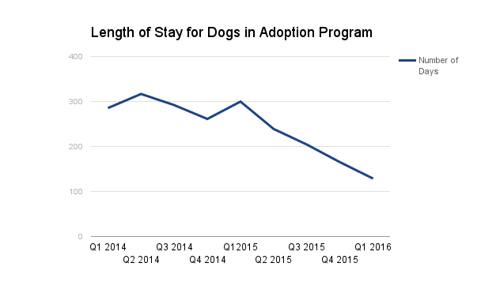
Impact

Slide 5
Dogs as individuals
Treating each dog as an individual, unique animal. And tracking the information about dogs which will be helpful for adopters.
Getting away from visual breed identification as a predictor of behavior.
Talking to clients about how and why dogs behave the way they do in the unnatural kennel environment.
Keeping negative-seeming behavioral notes about dogs OFF of the front of their kennels.
GETTING THE DOGS OUT OF THEIR KENNELS and into the company of adopters. Using life rooms and information about individual dogs.

Slide 6
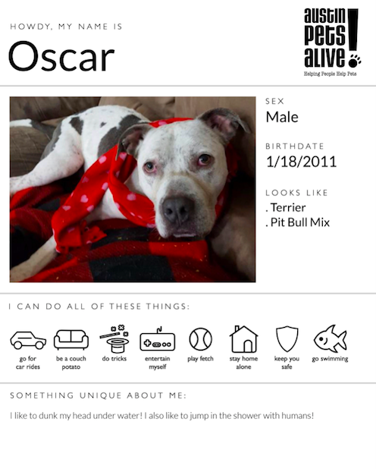
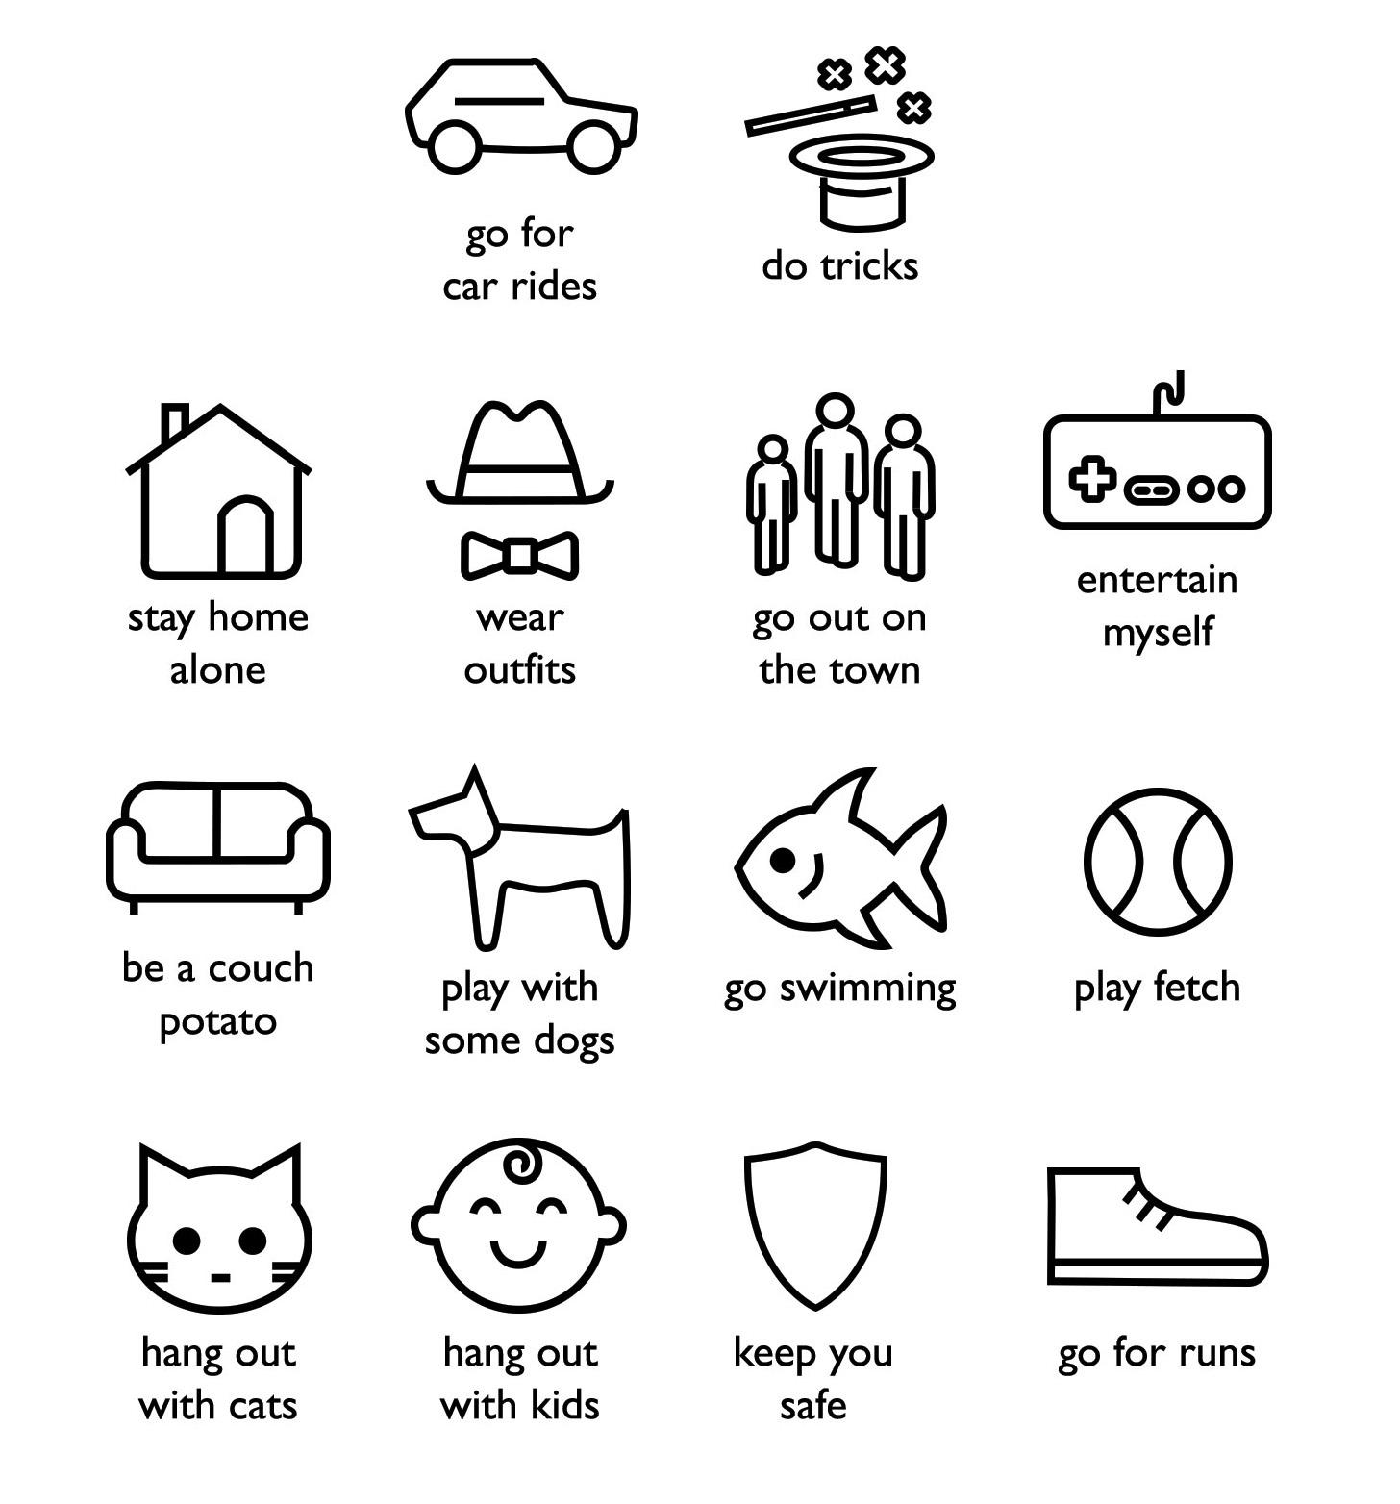
Dogs as individuals

Slide 7
Clients as individuals
Treating potential adopters as clients - not customers.
Proactive client service - engaging with clients from the moment they come in the door until the moment they leave.
Having someone who is responsible for ensuring a pleasant experience for the client. Following up throughout the process of the adoption.
Bedside manner - taking pride in our ability and to successfully navigate difficult conversations with adopters.
Having staff that can can conduct safe and productive introductions between dogs and clients

Slide 8
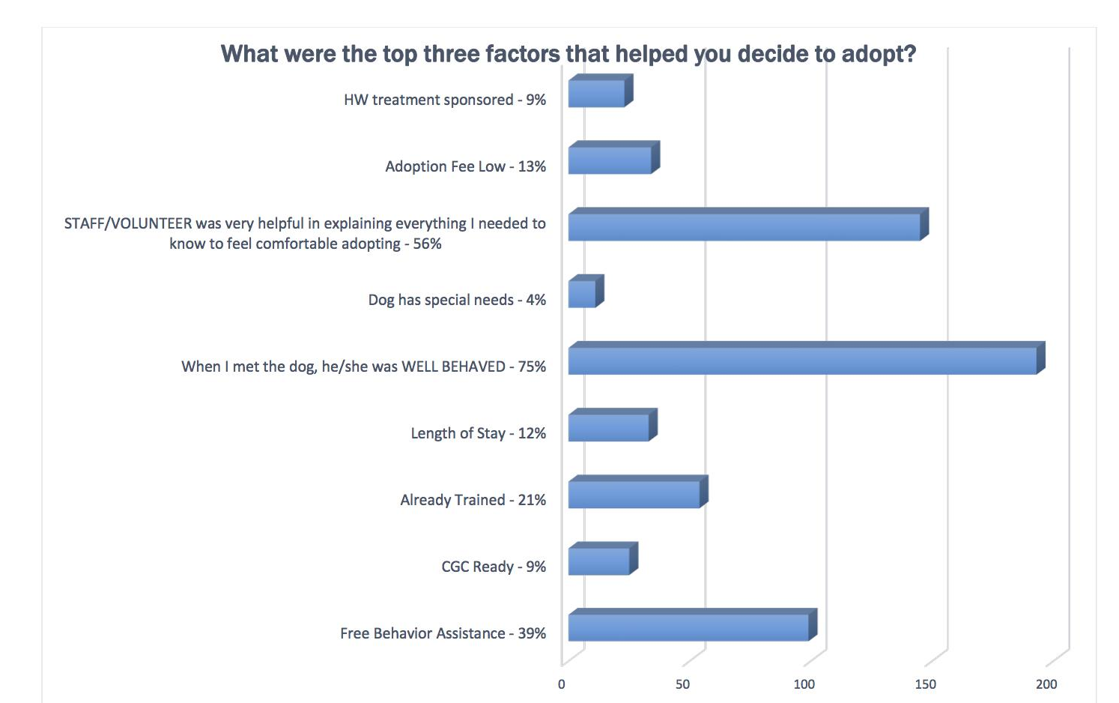
Results

Slide 9
Results

Slide 10
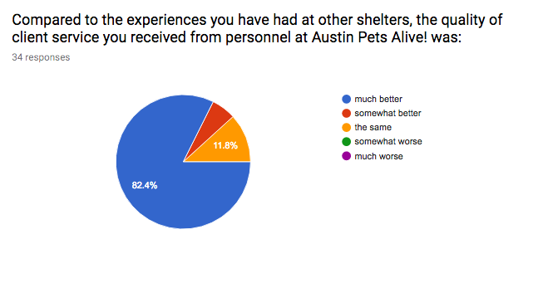
Results

Slide 11
For more information about the Matchmaker Placement Program please visit:
[url]
Copyright © 2017 Austin Pets Alive! All Rights Reserved

